Slide 1
Decision Tree Classifier
(Introduction, ID3 Algorithm)

Slide 2
Decision Tree Classifier - Introduction
Decision Tree Classifier is a supervised learning algorithm
It is a distribution-free or non-parametric method, which does not depend upon probability distribution assumptions.
Decision trees are one of the most important concepts in modern machine learning.
Not only are they an effective approach for classification and regression problems, but they are also the building block for more sophisticated algorithms like random forests and gradient boosting.

Slide 3
Decision Tree Classifier - Introduction
Decision trees can handle high dimensional data with good accuracy by constructing internal decision-making logic in a form of a decision tree.
A decision tree is a flowchart-like tree structure where
an internal node represents feature(or attribute)-represented as square,
the branch represents a decision rule,
and each leaf node represents the outcome- represented as ovals.
Conceptually, decision trees are quite simple. We split a dataset into smaller and smaller groups, attempting to make each one as “pure” or “homogenous” as possible.
Once we finish splitting, we use the final groups to make predictions on unseen data.

Slide 4
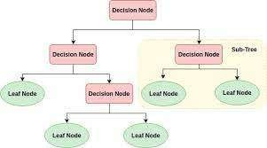
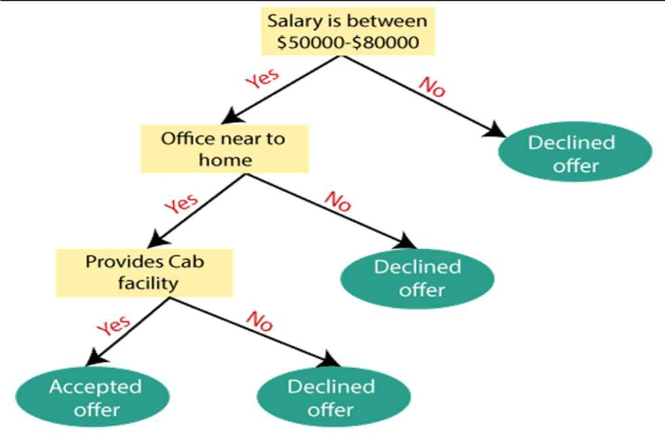
Decision Tree Classifier - Introduction
DECISION TREE- THAT ACCEPTS OR REJECTS A JOB OFFER ON THE BASIS OF SALARY, DISTANCE AND CAB FACILITY
GENERAL DECISION TREE STRUCTURE

Slide 5
Variants of Decision Tree Classifier
A successful decision tree is one that does a good job of “splitting” data into homogeneous groups.
Therefore, in order to build a good decision tree algorithm, we’ll need a method for evaluating splits.
There are several different different algorithm used to generate trees such as,
ID3
Uses information gain, to decide the partition feature,
not designed to deal with continuous features
CART (Classification and regression trees)
Uses Gini coefficient to decide partition feature
C4.5
Works similar to ID3 by using information gain to split data.
However C4.5 can handle continuous features, as well as can work with missing data

Slide 6
ID3 (Iterative Dichotomiser 3) Algorithm
ID3 stands for Iterative Dichotomiser 3 and is named such because the algorithm iteratively (repeatedly) dichotomizes(divides) features into two or more groups at each step.
Invented by Ross Quinlan, ID3 uses a top-down greedy approach to build a decision tree.
In simple words, the top-down approach means that we start building the tree from the top and the greedy approach means that at each iteration we select the best feature at the present moment to create a node.

Slide 7
ID3 (Iterative Dichotomiser 3) Algorithm
ID3 generates a tree by considering the whole set S as the root node.
It then iterates on every attribute and splits the data into fragments known as subsets to calculate the entropy or the information gain of that attribute.
After splitting, the algorithm recourses on every subset by taking those attributes which were not taken before into the iterated ones.
The best feature in ID3 is selected using Entropy and Information Gain metrics.

Slide 8
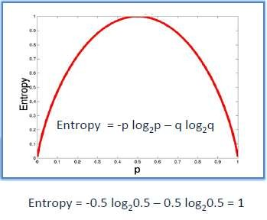
Entropy
It is defined as a measure of impurity present in the data.
Entropy calculates the homogeneity of a sample.
If the sample is completely homogeneous the entropy is zero and if the sample is equally divided it has entropy of one (as shown in figure for binary classes).
Entropy with the lowest value makes a model better in terms of prediction as it segregates the classes better.

Slide 9


Entropy (Contd…..)
Entropy of dataset (S) is computed as follows:
n
i 2 i
i=1
Where n is the total number of classes in the target column (in our case n = 2 i.e YES
and NO)
pᵢ is the probability of class ‘i’ or the ratio of “number of rows with class i in the target column” to the “total number of rows” in the dataset.

Slide 10
Information Gain
In a decision tree building process, two important decisions are to be made
what is the best split(s)
and which is the best variable to split a node.
Information Gain criteria helps in making these decisions.
We need to calculate Entropy of Parent and Child Nodes for calculating the information gain due to the split.
The concept of Information Gain is based on:
The more we know about a topic, the less new information you are apt to get about it. To be more concise: If you know an event is very probable, it is no surprise when it happens, that is, it gives us little information that it actually happened.
The amount of information gained is inversely proportional to the probability of an event happening.
We can also say that as the Entropy increases the information gain decreases. This is because Entropy refers to the probability of an event.

Slide 11




Information Gain (Contd…)
Information Gain = Entropy of Parent – sum (weighted % * Entropy of Child) Weighted % = Number of observations in particular child/sum (observations in all child nodes)
In particular, Information Gain for a feature column A is calculated as:
|v|
v
v
v=1
where Sᵥ is the set of rows in S for which the feature column A has value v, |Sᵥ| is the number of rows in Sᵥ and likewise |S| is the number of rows in S.
Information Gain calculates the reduction in the entropy and measures how well a given feature separates or classifies the target classes.
The feature with the highest Information Gain is selected as the best one.

Slide 12
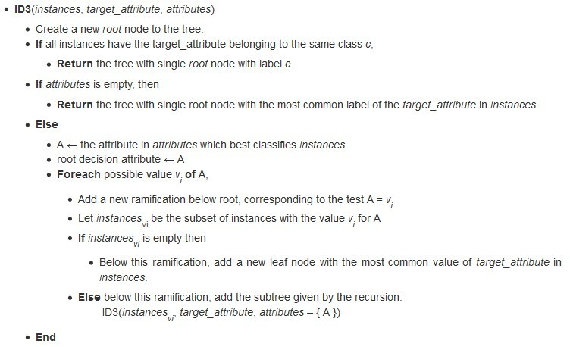
ID3 Algorithm-Pseudocode

Slide 13
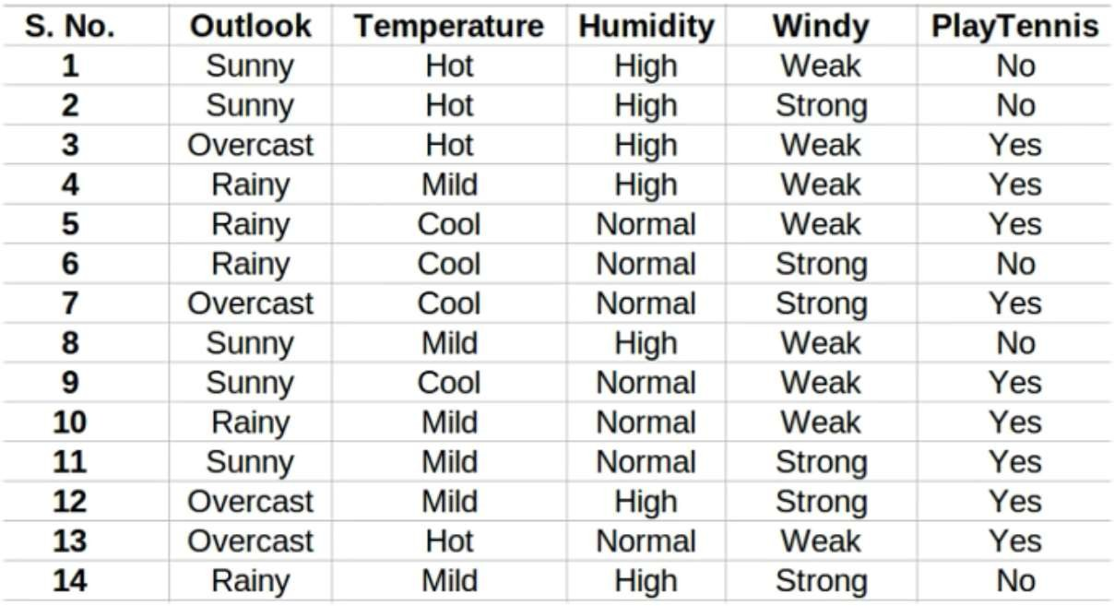
Numerical Example 1
Consider the weather dataset in which we have to decide that whether the player should play golf or not on the basis of weather conditions (shown in figure).
Train a decision tree classifier (using ID3 algorithm) that classifies any new test case according to given weather conditions.

Slide 14



Solution- Example 1
Compute Entropy of the entire dataset:
n
i=1 i
2 i
Positive Examples = 9
Negative Examples =5
Total= 14
 |  |  | 9 |  | 9 |  |  | 5 |  | 5
 |  |  | 9+5 | 2 | 9+5 |  |  | 9+5 | 2 | 9+5

Slide 15
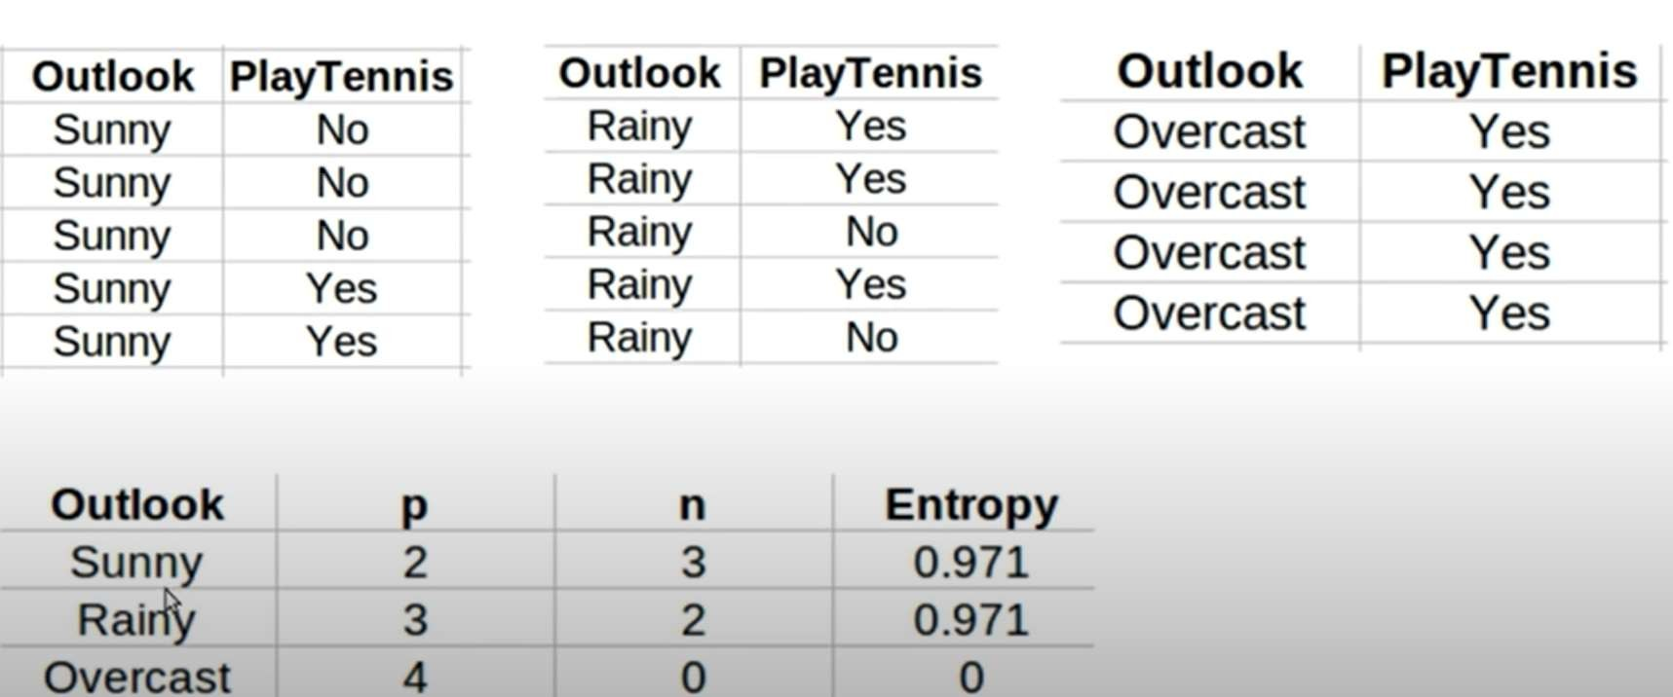

Solution- Example 1 (Contd…)
For each attribute: (let say Outlook)
Calculate Entropy of each values, i.e., ‘Sunny’, ‘Rainy’, ‘Overcast’
𝐸𝑛𝑡𝑟𝑜𝑝𝑦 𝑂𝑢𝑡𝑙𝑜𝑜𝑘 = 𝑆𝑢𝑛𝑛𝑦 = − ² 𝑙𝑜𝑔
2 ₋ 3
𝑙𝑜𝑔
3
2+3
= 0.971
2+3
2
2+3 2+3
2
𝐸𝑛𝑡𝑟𝑜𝑝𝑦 𝑂𝑢𝑡𝑙𝑜𝑜𝑘 = 𝑅𝑎𝑖𝑛𝑦 = − ³ 𝑙𝑜𝑔
3 ₋ 2
𝑙𝑜𝑔
2
2+3
= 0.971
2+3
2
2+3 2+3
2
𝐸𝑛𝑡𝑟𝑜𝑝𝑦 𝑂𝑢𝑡𝑙𝑜𝑜𝑘 = 𝑂𝑣𝑒𝑟𝑐𝑎𝑠𝑡 = − ⁴ 𝑙𝑜𝑔
4 ₋ 0
𝑙𝑜𝑔
0
4+0
= 0
2
2
4+0 4+0 4+0
|v|
𝐴𝑣𝑒𝑟𝑎𝑔𝑒 𝐼𝑛𝑓𝑜𝑟𝑚𝑎𝑡𝑖𝑜𝑛 𝐸𝑛𝑡𝑟𝑜𝑝𝑦 = Σ
v=1
𝑆
v
𝐸𝑛𝑡𝑟𝑜𝑝𝑦(𝑆 )
𝑆
v
𝐴𝑣𝑒𝑟𝑎𝑔𝑒 𝐼𝑛𝑓𝑜𝑟𝑚𝑎𝑡𝑖𝑜𝑛 𝐸𝑛𝑡𝑟𝑜𝑝𝑦 =
𝐼 𝑆, 𝑂𝑢𝑡𝑙𝑜𝑜𝑘 =
2 + 3 3 + 2
4 + 0
× 0.971 + × 0.971 + × 0 = 0.693
9 + 5 9 + 5 9 + 5
𝑰𝒏𝒇𝒐𝒓𝒎𝒂𝒕𝒊𝒐𝒏 𝑮𝒂𝒊𝒏 𝑺, 𝑶𝒖𝒕𝒍𝒐𝒐𝒌 = 𝑬𝒏𝒕𝒓𝒐𝒑𝒚 𝐒 − 𝐈 𝐒, 𝐎𝐮𝐭𝐥𝐨𝐨𝐤
= 𝟎. 𝟗𝟒𝟎 − 𝟎. 𝟔𝟗𝟑 =0.247

Slide 16
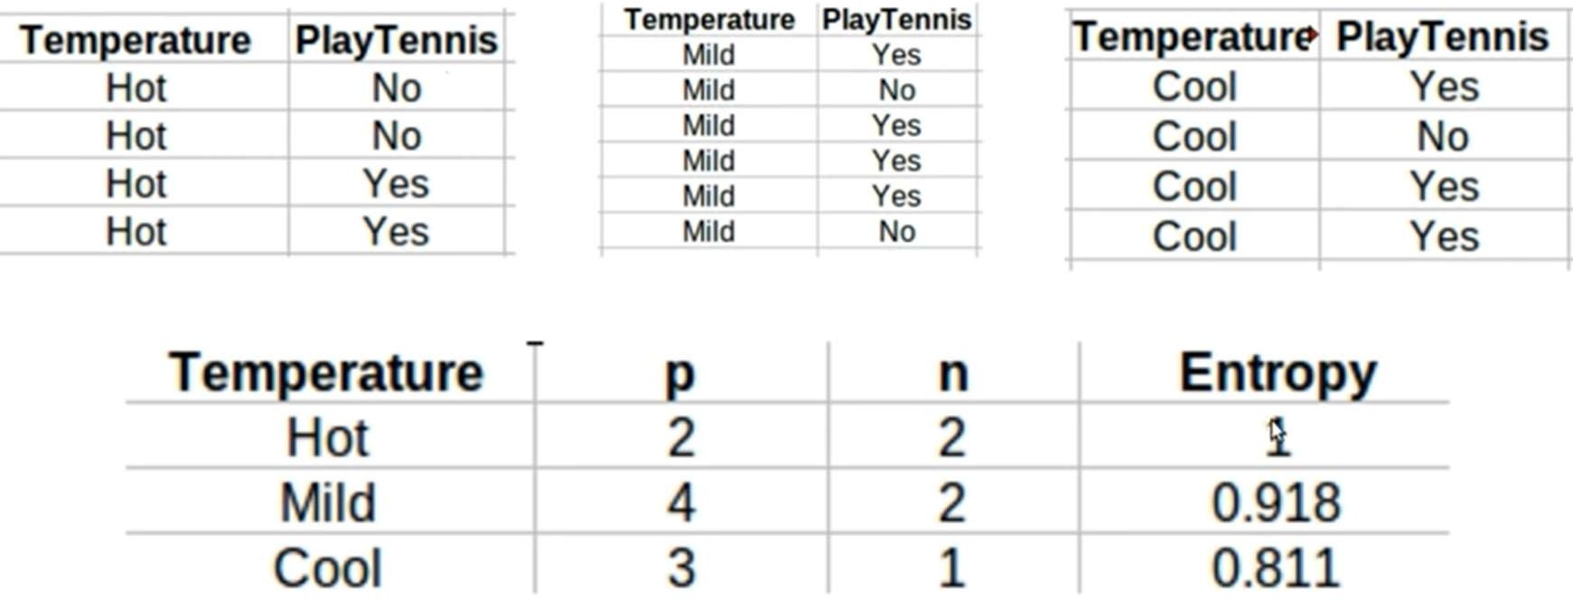

Solution- Example 1 (Contd…)
For each attribute: (let say Temperature)
Calculate Entropy of each values, i.e., ‘Hot’, ‘Mild’, ‘Cool’
2
2 2
2+2
2
2+2
𝐸𝑛𝑡𝑟𝑜𝑝𝑦 𝑇𝑒𝑚𝑝 = 𝐻𝑜𝑡 = − 𝑙𝑜𝑔
2
— 𝑙𝑜𝑔
2
= 0
2+2
2+2
4
4
4+2
3
3+1
2
2
4+2
1
3+1
𝐸𝑛𝑡𝑟𝑜𝑝𝑦 𝑇𝑒𝑚𝑝 = 𝑀𝑖𝑙𝑑 = − 𝑙𝑜𝑔
2
— 𝑙𝑜𝑔
2
= 0.918
4+2
4+2
3
1
𝐸𝑛𝑡𝑟𝑜𝑝𝑦 𝑇𝑒𝑚𝑝 = 𝐶𝑜𝑜𝑙 = − 𝑙𝑜𝑔
2
— 𝑙𝑜𝑔
2
= 0.811
3+1
3+1
|v|
𝐴𝑣𝑒𝑟𝑎𝑔𝑒 𝐼𝑛𝑓𝑜𝑟𝑚𝑎𝑡𝑖𝑜𝑛 𝐸𝑛𝑡𝑟𝑜𝑝𝑦 = Σ
v=1
𝑆
v
𝐸𝑛𝑡𝑟𝑜𝑝𝑦(𝑆 )
𝑆
v
𝐴𝑣𝑒𝑟𝑎𝑔𝑒 𝐼𝑛𝑓𝑜𝑟𝑚𝑎𝑡𝑖𝑜𝑛 𝐸𝑛𝑡𝑟𝑜𝑝𝑦 = 2 + 2 4 + 2 3 + 1
𝐼 𝑆, 𝑇𝑒𝑚𝑝 = ₉ ₊ ₅ × 1 + ₉ ₊ ₅ × 0.918 + ₉ ₊ ₅ × 0.811 = 0.911
𝑰𝒏𝒇𝒐𝒓𝒎𝒂𝒕𝒊𝒐𝒏 𝑮𝒂𝒊𝒏 𝑺, 𝑻𝒆𝒎𝒑 = 𝑬𝒏𝒕𝒓𝒐𝒑𝒚 𝐒 − 𝐈 𝐒, 𝑻𝒆𝒎𝒑
= 𝟎. 𝟗𝟒𝟎 − 𝟎. 𝟗𝟏𝟏 =0.029

Slide 17
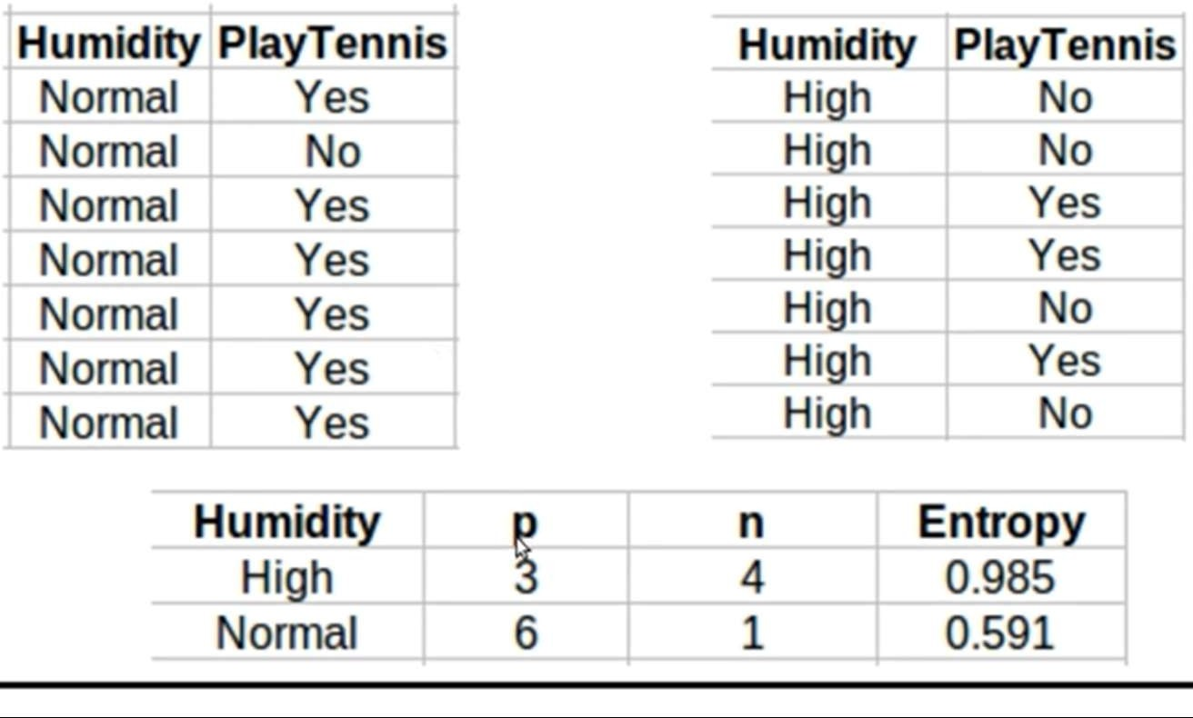

Solution- Example 1 (Contd…)
For each attribute: (let say Humidity)
Calculate Entropy of each values, i.e., ‘High’, ‘Normal’,
3 3
4
4
3+4
𝐸𝑛𝑡𝑟𝑜𝑝𝑦 𝐻𝑢𝑚𝑖𝑑𝑖𝑡𝑦 = 𝐻𝑖𝑔ℎ = − 𝑙𝑜𝑔
2
— 𝑙𝑜𝑔
2
= 0.985
3+4
3+4 3+4
6
6
1
1
6+1
𝐸𝑛𝑡𝑟𝑜𝑝𝑦 𝐻𝑢𝑛𝑖𝑑𝑖𝑡𝑦 = 𝑁𝑜𝑟𝑚𝑎𝑙 = − 𝑙𝑜𝑔
2
— 𝑙𝑜𝑔
2
= 0.591
6+1
6+1 6+1
|v|
𝐴𝑣𝑒𝑟𝑎𝑔𝑒 𝐼𝑛𝑓𝑜𝑟𝑚𝑎𝑡𝑖𝑜𝑛 𝐸𝑛𝑡𝑟𝑜𝑝𝑦 = Σ
v=1
𝑆
v
𝐸𝑛𝑡𝑟𝑜𝑝𝑦(𝑆 )
𝑆
v
𝐴𝑣𝑒𝑟𝑎𝑔𝑒 𝐼𝑛𝑓𝑜𝑟𝑚𝑎𝑡𝑖𝑜𝑛 𝐸𝑛𝑡𝑟𝑜𝑝𝑦 = 3 + 4 6 + 1
𝐼 𝑆, 𝐻𝑢𝑚𝑖𝑑𝑖𝑡𝑦 = ₉ ₊ ₅ × 0.985 + ₉ ₊ ₅ × 0.591 = 0.788
𝑰𝒏𝒇𝒐𝒓𝒎𝒂𝒕𝒊𝒐𝒏 𝑮𝒂𝒊𝒏 𝑺, 𝑯𝒖𝒎𝒅𝒊𝒕𝒚
= 𝑬𝒏𝒕𝒓𝒐𝒑𝒚 𝐒 − 𝐈 𝐒, 𝑯𝒖𝒎𝒊𝒅𝒊𝒕𝒚
= 𝟎. 𝟗𝟒𝟎 − 𝟎. 𝟕𝟖8 = 0.152

Slide 18
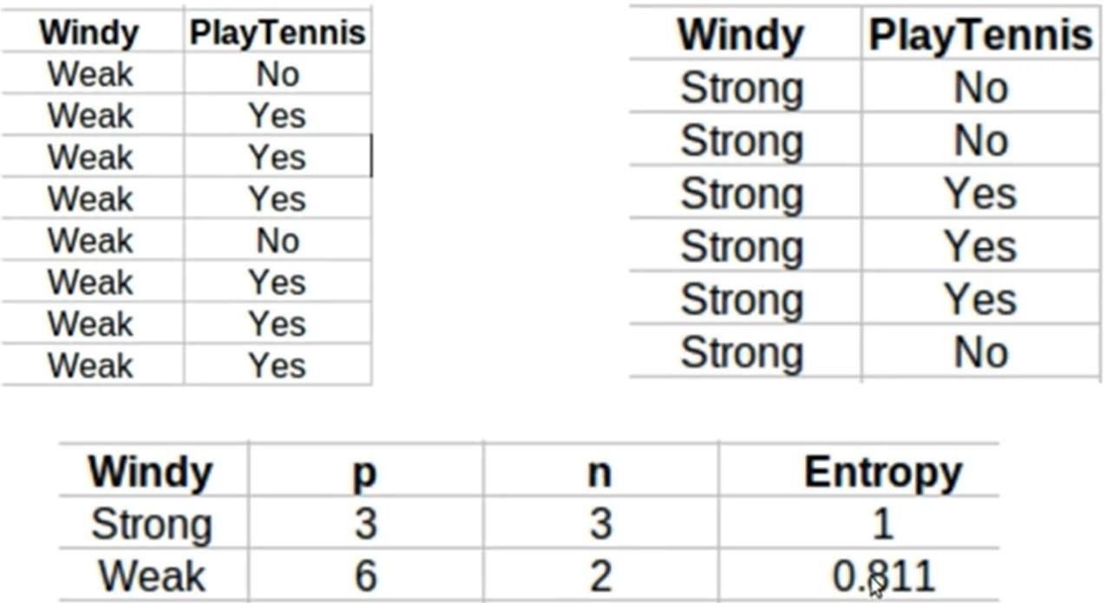

Solution- Example 1 (Contd…)
For each attribute: (let say Windy)
Calculate Entropy of each values, i.e., ‘Strong’, ‘Weak’,
3
3 3
3+3
3
3+3
𝐸𝑛𝑡𝑟𝑜𝑝𝑦 𝑊𝑖𝑛𝑑𝑦 = 𝑆𝑡𝑟𝑜𝑛𝑔 = − 𝑙𝑜𝑔
2
— 𝑙𝑜𝑔
2
= 1
3+3
3+3
6
6
2
2
6+2
𝐸𝑛𝑡𝑟𝑜𝑝𝑦 𝑊𝑖𝑛𝑑𝑦 = 𝑊𝑒𝑎𝑘 = − 𝑙𝑜𝑔
2
— 𝑙𝑜𝑔
2
= 0.811
6+2 6+2 6+1
|v|
𝐴𝑣𝑒𝑟𝑎𝑔𝑒 𝐼𝑛𝑓𝑜𝑟𝑚𝑎𝑡𝑖𝑜𝑛 𝐸𝑛𝑡𝑟𝑜𝑝𝑦 = Σ
v=1
𝑆
v
𝐸𝑛𝑡𝑟𝑜𝑝𝑦(𝑆 )
𝑆
v
𝐴𝑣𝑒𝑟𝑎𝑔𝑒 𝐼𝑛𝑓𝑜𝑟𝑚𝑎𝑡𝑖𝑜𝑛 𝐸𝑛𝑡𝑟𝑜𝑝𝑦 =
𝐼 𝑆, 𝑊𝑖𝑛𝑑𝑦 =
3 + 3 6 + 2
× 1 + × 0.811 = 0.892
9 + 5 9 + 5
𝑰𝒏𝒇𝒐𝒓𝒎𝒂𝒕𝒊𝒐𝒏 𝑮𝒂𝒊𝒏 𝑺, 𝑾𝒊𝒏𝒅𝒚 = 𝑬𝒏𝒕𝒓𝒐𝒑𝒚 𝐒 − 𝐈 𝐒, 𝑾𝒊𝒏𝒅𝒚
= 𝟎. 𝟗𝟒𝟎 − 𝟎. 𝟖𝟗𝟐 = 0.048
Since Information Gain for Outlook is max, therefore root is Outlook

Slide 19
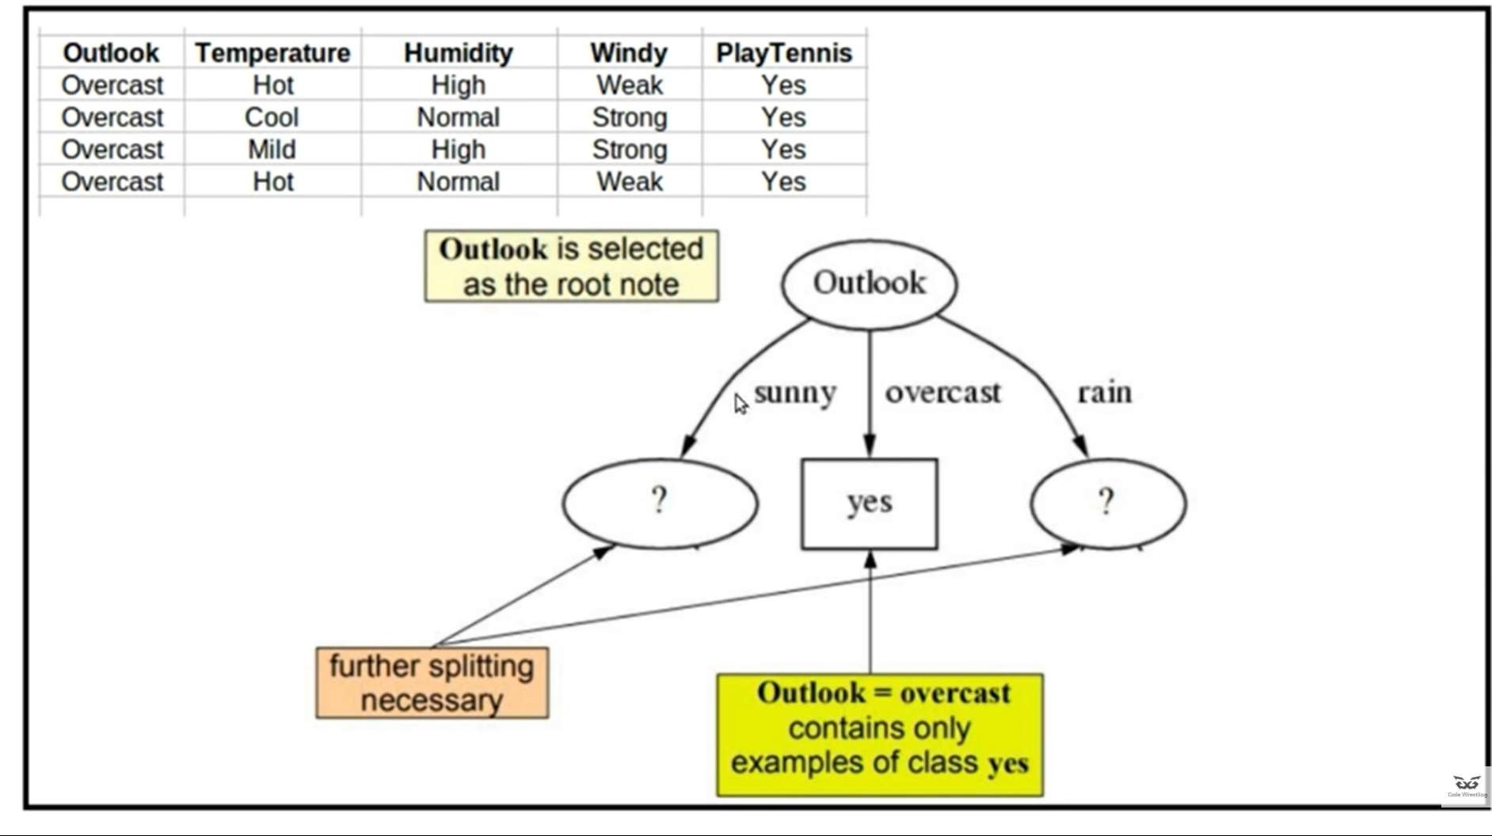
Solution- Example 1 (Contd…)

Slide 20
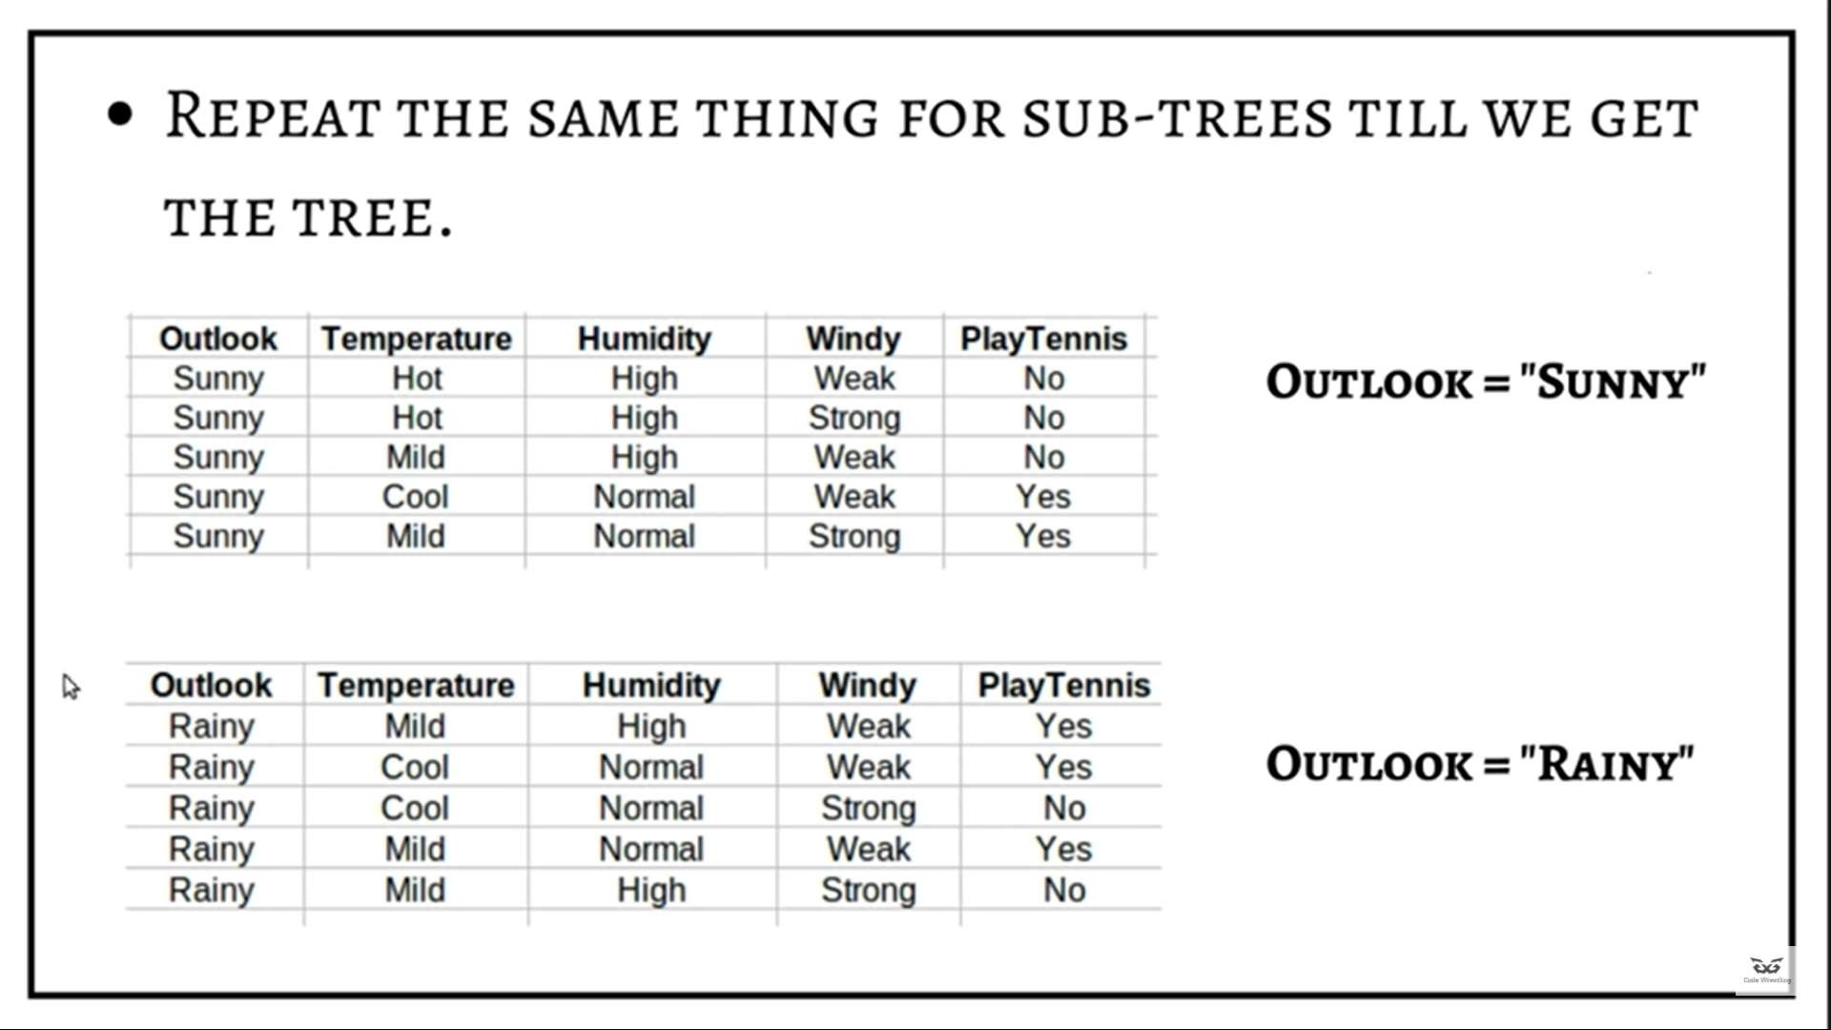
Solution- Example 1 (Contd…)

Slide 21
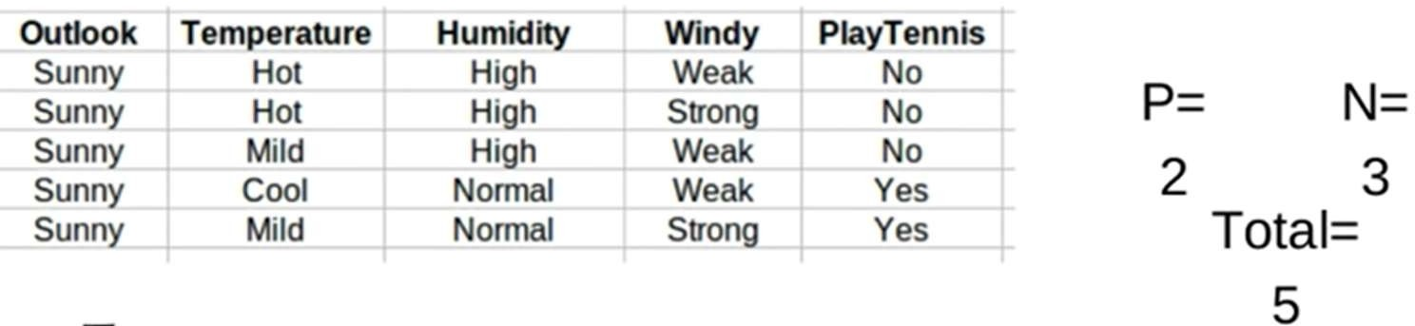
Solution- Example 1 (Contd…)
Compute Entropy of the Sunny:
𝐸𝑛𝑡𝑟𝑜𝑝𝑦
^{𝑆}sunny
= − ∑^{n}
𝑝_{i}𝑙𝑜𝑔₂(𝑝_{i})
i=1
𝐸𝑛𝑡𝑟𝑜𝑝𝑦 𝑆
= −
2
𝑙𝑜𝑔
2
−
3 3
sunny
2
𝑙𝑜𝑔
2
= 0.971
2+3
2+3
2+3 2+3

Slide 22
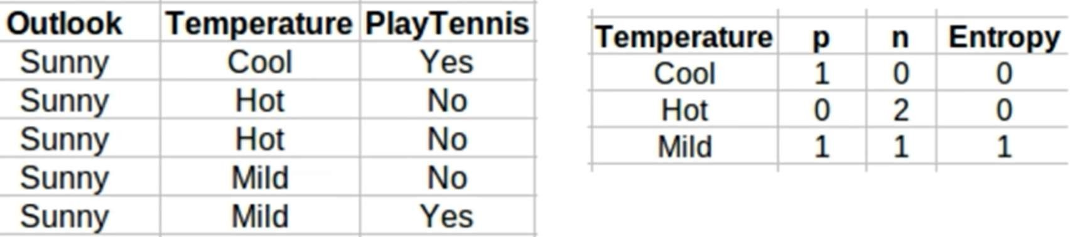
Solution- Example 1 (Contd…)
For each attribute: (let say Temperatre)
Calculate Entropy of each values, i.e., ‘Hot’, ‘Mild’, ‘Cool’
𝐸𝑛𝑡𝑟𝑜𝑝𝑦 𝑇𝑒𝑚𝑝 = 𝐻𝑜𝑡 = − ⁰ 𝑙𝑜𝑔
0 ₋ 2
𝑙𝑜𝑔
2
2+0
= 0
0+2
2
0+2 2+0
2
𝐸𝑛𝑡𝑟𝑜𝑝𝑦 𝑇𝑒𝑚𝑝 = 𝑀𝑖𝑙𝑑 = − ¹ 𝑙𝑜𝑔
1 ₋ 1
𝑙𝑜𝑔
1
1+1
0
1+0
= 1
1+1
2
1+1 1+1
2
𝐸𝑛𝑡𝑟𝑜𝑝𝑦 𝑇𝑒𝑚𝑝 = 𝐶𝑜𝑜𝑙 = − ¹ 𝑙𝑜𝑔
1 ₋ 0
𝑙𝑜𝑔
= 0
2 2
1+0 1+0 1+0
|v|
𝐴𝑣𝑒𝑟𝑎𝑔𝑒 𝐼𝑛𝑓𝑜𝑟𝑚𝑎𝑡𝑖𝑜𝑛 𝐸𝑛𝑡𝑟𝑜𝑝𝑦 = Σ
v=1
𝑆
v
𝐸𝑛𝑡𝑟𝑜𝑝𝑦(𝑆 )
𝑆
v
𝐴𝑣𝑒𝑟𝑎𝑔𝑒 𝐼𝑛𝑓𝑜𝑟𝑚𝑎𝑡𝑖𝑜𝑛 𝐸𝑛𝑡𝑟𝑜𝑝𝑦 =
0 + 2 1 + 1 1 + 0
𝐼 𝑆_{sunny}, 𝑇𝑒𝑚𝑝𝑒𝑟𝑎𝑡𝑢𝑟𝑒 = ₂ ₊ ₃ × 0 + ₂ ₊ ₃ × 1 + ₂ ₊ ₃ × 0 = 0.4
𝑰𝒏𝒇𝒐𝒓𝒎𝒂𝒕𝒊𝒐𝒏 𝑮𝒂𝒊𝒏 𝑆_{sunny}, 𝑻𝒆𝒎𝒑
= 𝑬𝒏𝒕𝒓𝒐𝒑𝒚 𝑆_{sunny} − 𝐈 𝑆_{sunny}, 𝑻𝒆𝒎𝒑
= 𝟎. 𝟗𝟕𝟏 − 𝟎. 𝟒 =0.571

Slide 23
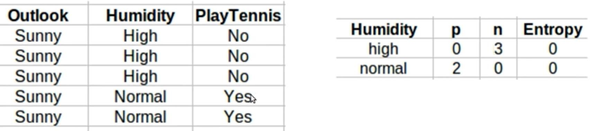
Solution- Example 1 (Contd…)
For each attribute: (let say Humidity)
Calculate Entropy of each values, i.e., ‘High’, ‘Normal’
0
0 3
0+3
3
3+0
𝐸𝑛𝑡𝑟𝑜𝑝𝑦 𝐻𝑚𝑖𝑑𝑖𝑡𝑦 = 𝐻𝑖𝑔ℎ = − 𝑙𝑜𝑔
2
— 𝑙𝑜𝑔
2
= 0
0+3
3+0
2
2
0
0
0+2
𝐸𝑛𝑡𝑟𝑜𝑝𝑦 𝐻𝑢𝑚𝑖𝑑𝑖𝑡𝑦 = 𝑁𝑜𝑟𝑚𝑎𝑙 = − 𝑙𝑜𝑔
2
— 𝑙𝑜𝑔
2
= 0
2+0 2+0 0+2
|v|
𝐴𝑣𝑒𝑟𝑎𝑔𝑒 𝐼𝑛𝑓𝑜𝑟𝑚𝑎𝑡𝑖𝑜𝑛 𝐸𝑛𝑡𝑟𝑜𝑝𝑦 = Σ
v=1
𝑆
v
𝐸𝑛𝑡𝑟𝑜𝑝𝑦(𝑆 )
𝑆
v
𝐴𝑣𝑒𝑟𝑎𝑔𝑒 𝐼𝑛𝑓𝑜𝑟𝑚𝑎𝑡𝑖𝑜𝑛 𝐸𝑛𝑡𝑟𝑜𝑝𝑦 =
0 + 3 2 + 0
𝐼 𝑆_{sunny}, 𝐻𝑢𝑚𝑖𝑑𝑖𝑡𝑦 = ₂ ₊ ₃ × 0 + ₂ ₊ ₃ × 0 = 0
𝑰𝒏𝒇𝒐𝒓𝒎𝒂𝒕𝒊𝒐𝒏 𝑮𝒂𝒊𝒏 𝑆_{sunny}, 𝐻𝑢𝑚𝑖𝑑𝑖𝑡𝑦
= 𝑬𝒏𝒕𝒓𝒐𝒑𝒚 𝑆_{sunny} − 𝐈 𝑆_{sunny}, 𝐻𝑢𝑚𝑖𝑑𝑖𝑡𝑦
= 𝟎. 𝟗𝟕𝟏 − 𝟎 =0.971

Slide 24
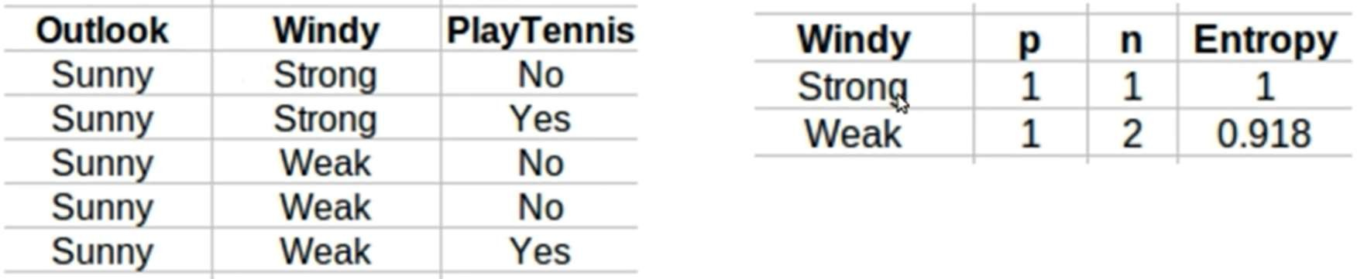
Solution- Example 1 (Contd…)
For each attribute: (let say Windy)
Calculate Entropy of each values, i.e., ‘Strong’, ‘False’
𝐸𝑛𝑡𝑟𝑜𝑝𝑦𝑊𝑖𝑛𝑑𝑦 = 𝑆𝑡𝑟𝑜𝑛𝑔) = − ¹ 𝑙𝑜𝑔
1 ₋ 1
𝑙𝑜𝑔
1
1+1
= 1
1+1
2
1+1 1+1
2
𝐸𝑛𝑡𝑟𝑜𝑝𝑦 𝑊𝑖𝑛𝑑𝑦 = 𝑊𝑒𝑎𝑘 = − ¹ 𝑙𝑜𝑔
1 ₋ 2
𝑙𝑜𝑔
2
1+2
= 0.918
2
2
1+2 1+2 1+2
|v|
𝐴𝑣𝑒𝑟𝑎𝑔𝑒 𝐼𝑛𝑓𝑜𝑟𝑚𝑎𝑡𝑖𝑜𝑛 𝐸𝑛𝑡𝑟𝑜𝑝𝑦 = Σ
v=1
𝑆
v
𝐸𝑛𝑡𝑟𝑜𝑝𝑦(𝑆 )
𝑆
v
𝐴𝑣𝑒𝑟𝑎𝑔𝑒 𝐼𝑛𝑓𝑜𝑟𝑚𝑎𝑡𝑖𝑜𝑛 𝐸𝑛𝑡𝑟𝑜𝑝𝑦 =
1 + 1 1 + 2
𝐼 𝑆_{sunny}, 𝑊𝑖𝑛𝑑𝑦 = ₂ ₊ ₃ × 1 + ₂ ₊ ₃ × .918 = 0.951
𝑰𝒏𝒇𝒐𝒓𝒎𝒂𝒕𝒊𝒐𝒏 𝑮𝒂𝒊𝒏 𝑆_{sunny}, 𝑾𝒊𝒏𝒅𝒚
= 𝑬𝒏𝒕𝒓𝒐𝒑𝒚 𝑆_{sunny} − 𝐈 𝑆_{sunny}, 𝑊𝑖𝑛𝑑𝑦
= 𝟎. 𝟗𝟕𝟏 − 𝟎. 𝟗𝟓𝟏 =0.020
Since Information Gain for root Sunny is maximum for Humidity, So, the node for Split under Outlook=Sunny is Humidity

Slide 25
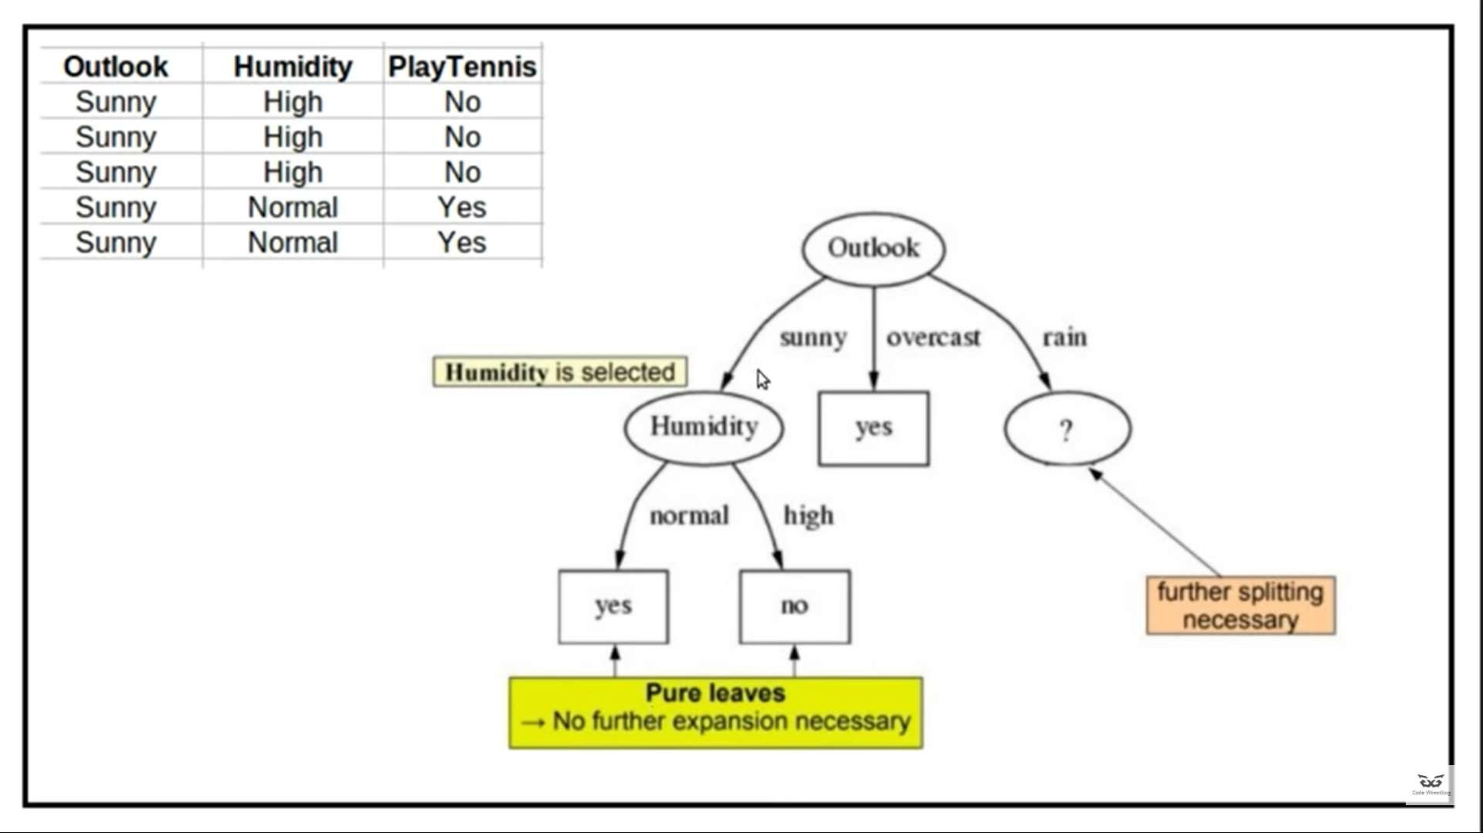
Solution- Example 1 (Contd…)

Slide 26
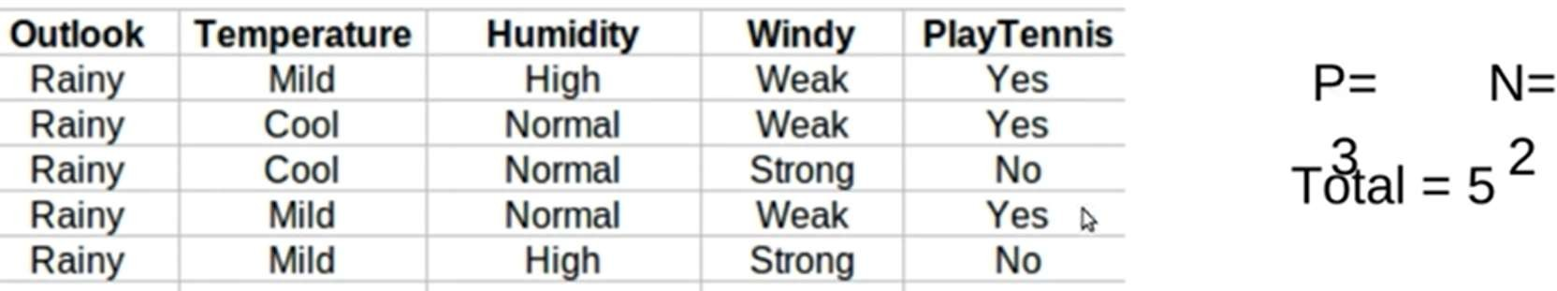
Solution- Example 1 (Contd…)
Compute Entropy of the Outlook=Rainy:
𝐸𝑛𝑡𝑟𝑜𝑝𝑦
^{𝑆}rainy
= − ∑^{n}
𝑝_{i}𝑙𝑜𝑔₂(𝑝_{i})
i=1
𝐸𝑛𝑡𝑟𝑜𝑝𝑦 𝑆
= −
3
𝑙𝑜𝑔
3
−
2 2
rainy
2
𝑙𝑜𝑔
2
= 0.971
2+3
2+3
2+3 2+3

Slide 27
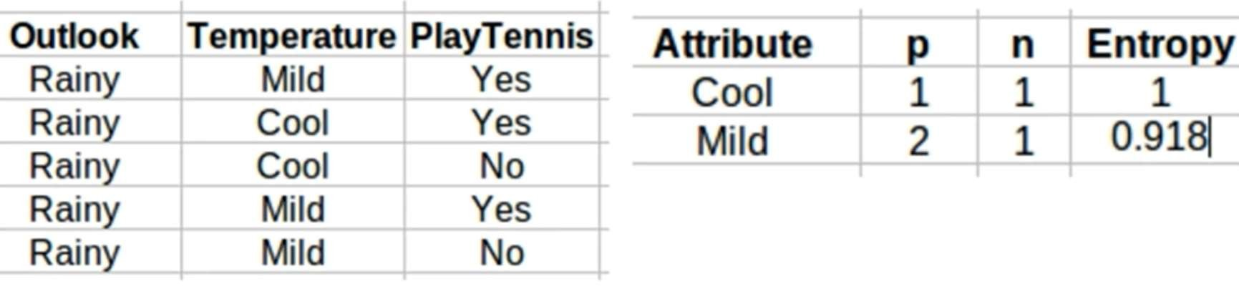
Solution- Example 1 (Contd…)
For each attribute: (let say Temperature)
Calculate Entropy of each values, i.e., ‘Mild’, ‘Cool’
2
2 1
2+1
1
2+1
𝐸𝑛𝑡𝑟𝑜𝑝𝑦 𝑇𝑒𝑚𝑝 = 𝑀𝑖𝑙𝑑 = − 𝑙𝑜𝑔
2
— 𝑙𝑜𝑔
2
= 0.918
2+1
2+1
1
1 1
1+1 1+1
1
1+1
𝐸𝑛𝑡𝑟𝑜𝑝𝑦 𝑇𝑒𝑚𝑝 = 𝐶𝑜𝑜𝑙 = − 𝑙𝑜𝑔
2
— 𝑙𝑜𝑔
2
= 1
1+1
|v|
𝐴𝑣𝑒𝑟𝑎𝑔𝑒 𝐼𝑛𝑓𝑜𝑟𝑚𝑎𝑡𝑖𝑜𝑛 𝐸𝑛𝑡𝑟𝑜𝑝𝑦 = Σ
v=1
𝑆
v
𝐸𝑛𝑡𝑟𝑜𝑝𝑦(𝑆 )
𝑆
v
𝐴𝑣𝑒𝑟𝑎𝑔𝑒 𝐼𝑛𝑓𝑜𝑟𝑚𝑎𝑡𝑖𝑜𝑛 𝐸𝑛𝑡𝑟𝑜𝑝𝑦 =
2 + 1 1 + 1
𝐼 𝑆_{rainy}, 𝑇𝑒𝑚𝑝𝑒𝑟𝑎𝑡𝑢𝑟𝑒 = ₃ ₊ ₂ × 0.918 + ₃ ₊ ₂ × 1 = 0.951
𝑰𝒏𝒇𝒐𝒓𝒎𝒂𝒕𝒊𝒐𝒏 𝑮𝒂𝒊𝒏 𝑆_{rainy} 𝑻𝒆𝒎𝒑
= 𝑬𝒏𝒕𝒓𝒐𝒑𝒚 𝑆_{rainy} − 𝐈 𝑆_{rainy}, 𝑻𝒆𝒎𝒑
= 𝟎. 𝟗𝟕𝟏 − 𝟎. 𝟗𝟓𝟏 =0.020

Slide 28
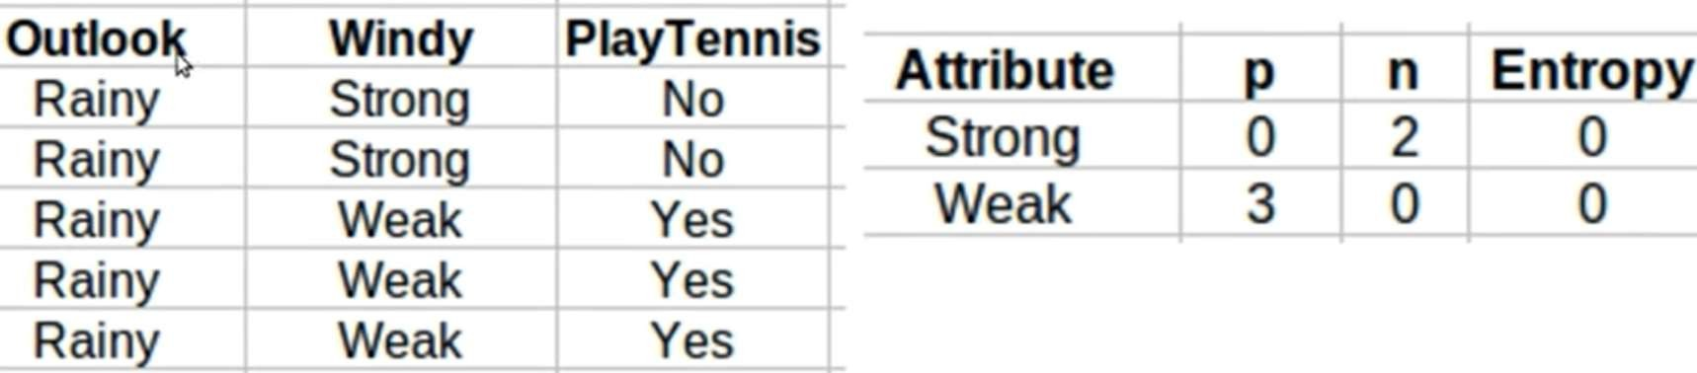
Solution- Example 1 (Contd…)
For each attribute: (let say Windy)
Calculate Entropy of each values, i.e., ‘Strong’, ‘Weak’
0
0 2
0+2
2
0+2
𝐸𝑛𝑡𝑟𝑜𝑝𝑦 𝑊𝑖𝑛𝑑𝑦 = 𝑆𝑡𝑟𝑜𝑛𝑔 = − 𝑙𝑜𝑔
2
— 𝑙𝑜𝑔
2
= 0
0+2
0+2
3
3
0
0
0+3
𝐸𝑛𝑡𝑟𝑜𝑝𝑦 𝑊𝑖𝑛𝑑𝑦 = 𝑊𝑒𝑎𝑘 = − 𝑙𝑜𝑔
— 𝑙𝑜𝑔
= 0
3+0
2
3+0 0+3
|v|
2
𝐴𝑣𝑒𝑟𝑎𝑔𝑒 𝐼𝑛𝑓𝑜𝑟𝑚𝑎𝑡𝑖𝑜𝑛 𝐸𝑛𝑡𝑟𝑜𝑝𝑦 = Σ
v=1
𝑆
v
𝐸𝑛𝑡𝑟𝑜𝑝𝑦(𝑆 )
𝑆
v
𝐴𝑣𝑒𝑟𝑎𝑔𝑒 𝐼𝑛𝑓𝑜𝑟𝑚𝑎𝑡𝑖𝑜𝑛 𝐸𝑛𝑡𝑟𝑜𝑝𝑦 =
0 + 2 3 + 0
𝐼 𝑆_{rainy}, 𝑊𝑖𝑛𝑑𝑦 = ₃ ₊ ₂ × 0 + ₃ ₊ ₂ × 0 = 0
𝑰𝒏𝒇𝒐𝒓𝒎𝒂𝒕𝒊𝒐𝒏 𝑮𝒂𝒊𝒏 𝑆_{rainy}, 𝑊𝑖𝑛𝑑𝑦
= 𝑬𝒏𝒕𝒓𝒐𝒑𝒚 𝑆_{rainy} − 𝐈 𝑆_{rainy}, 𝑾𝒊𝒏𝒅𝒚
= 𝟎. 𝟗𝟕𝟏 − 𝟎 =0.971

Slide 29
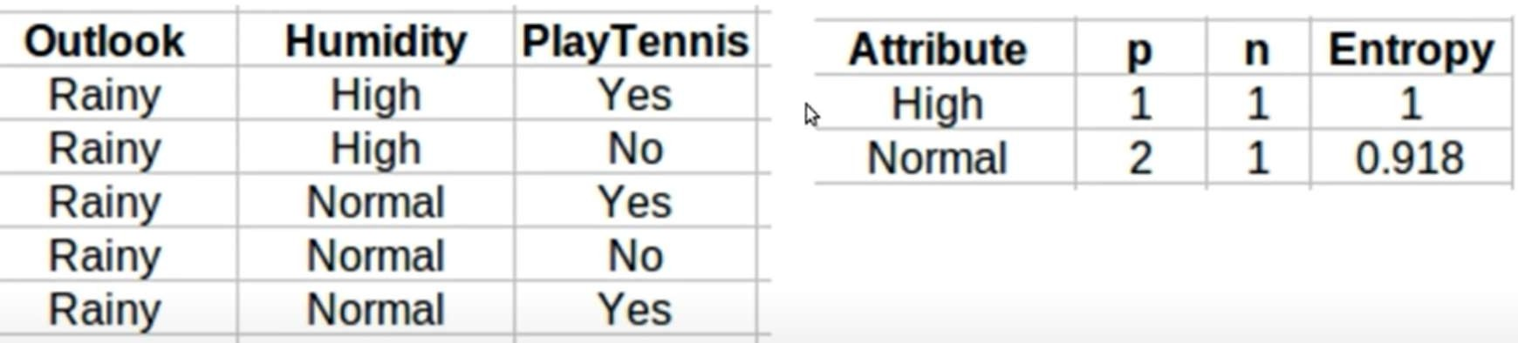
Solution- Example 1 (Contd…)
For each attribute: (let say Humidity)
Calculate Entropy of each values, i.e., ‘High’, Normal’
𝐸𝑛𝑡𝑟𝑜𝑝𝑦 𝐻𝑢𝑚𝑖𝑑𝑖𝑡𝑦 = 𝐻𝑖𝑔ℎ = − ¹ 𝑙𝑜𝑔
1 ₋ 1
𝑙𝑜𝑔
1
1+1
= 1
1+1
2
1+1 1+1
2
𝐸𝑛𝑡𝑟𝑜𝑝𝑦 𝐻𝑢𝑚𝑖𝑑𝑖𝑡𝑦 = 𝑁𝑜𝑟𝑚𝑎𝑙 = − ² 𝑙𝑜𝑔
2 ₋ 1
𝑙𝑜𝑔
1
1+2
= 0.918
2
2
2+1 2+1 2+1
|v|
𝐴𝑣𝑒𝑟𝑎𝑔𝑒 𝐼𝑛𝑓𝑜𝑟𝑚𝑎𝑡𝑖𝑜𝑛 𝐸𝑛𝑡𝑟𝑜𝑝𝑦 = Σ
v=1
𝑆
v
𝐸𝑛𝑡𝑟𝑜𝑝𝑦(𝑆 )
𝑆
v
𝐴𝑣𝑒𝑟𝑎𝑔𝑒 𝐼𝑛𝑓𝑜𝑟𝑚𝑎𝑡𝑖𝑜𝑛 𝐸𝑛𝑡𝑟𝑜𝑝𝑦 =
1 + 1 2 + 1
𝐼 𝑆_{rainy}, 𝐻𝑢𝑚𝑖𝑑𝑖𝑡𝑦 = ₃ ₊ ₂ × 1 + ₃ ₊ ₂ × 0.918 = 0.951
𝑰𝒏𝒇𝒐𝒓𝒎𝒂𝒕𝒊𝒐𝒏 𝑮𝒂𝒊𝒏 𝑆_{rainy}, 𝑯𝒖𝒎𝒊𝒅𝒊𝒕𝒚
= 𝑬𝒏𝒕𝒓𝒐𝒑𝒚 𝑆_{rainy} − 𝐈 𝑆_{rainy}, 𝑯𝒖𝒎𝒊𝒅𝒊𝒕𝒚
= 𝟎. 𝟗𝟕𝟏−. 𝟗𝟓𝟏 =0.020
Since Information Gain for root Outlook=Rainy is maximum for Windy, So, the node for Split under Outlook=Runny is Windy

Slide 30
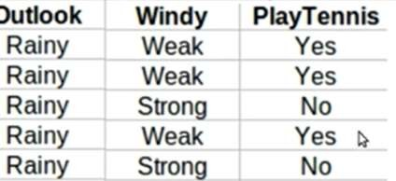
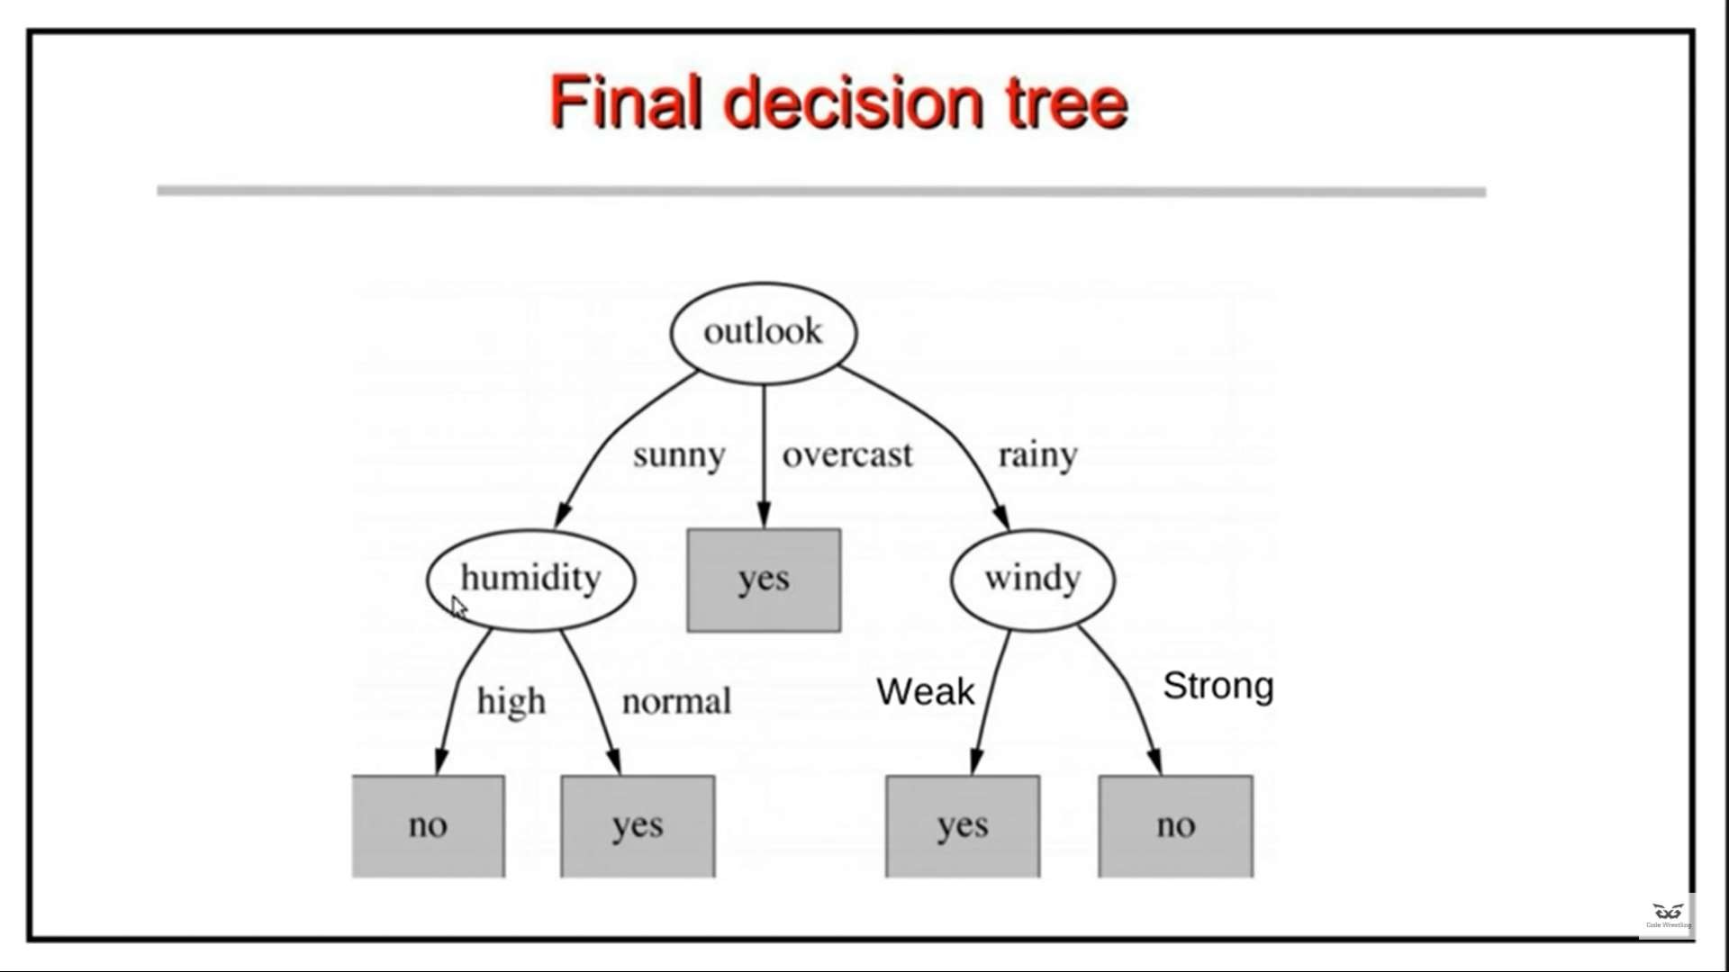
Solution- Example 1 (Contd…)

Slide 31
Limitations of ID3 Algorithm
ID3 can handle only categorical values and not continuous valued features.
ID3 cannot handle incomplete data.
ID3 algorithm is biased towards the feature which has large number of distinct values.
This is due to the reason that feature is chosen on the basis of Information gain which is the difference between Entropy of parent set and average information entropy of feature.
So, if a feature has large number of distinct values, then reduction in entropy would be large.

Slide 32
Limitations of ID3 Algorithm (Contd….)
Overfitting:
ID3 algorithm grows each branch of the tree just deeply enough to perfectly classify the training examples.
But it can lead to difficulties when there is noise in the data, or when the number of training examples is too small to produce a representative sample of the true target function.
For example, consider a new instance in weather dataset, <Sunny, Hot, Normal, Strong, -> Example is noisy because the correct label is +.
The addition of this incorrect example will now cause ID3 to construct a more complex tree.
The result is that ID3 will output a decision tree (h) that is more complex than the original tree (h’) which will perform quite well on training data but poor on test data.
However, given that the new decision node is simply a consequence of fitting the noisy training example.

Slide 33
Avoiding Overfitting
There are several approaches to avoiding overfitting in decision tree learning. These can be grouped into two classes:
Pre-pruning (avoidance):
Stop growing the tree earlier, before it reaches the point where it perfectly classifies the training data
Post-pruning (recovery):
Allow the tree to overfit the data, and then post-prune the tree.
Although the first of these approaches might seem more direct, the second approach of post- pruning overfit trees has been found to be more successful in practice.
This is due to the difficulty in the first approach of estimating precisely when to stop growing the tree.

Slide 34
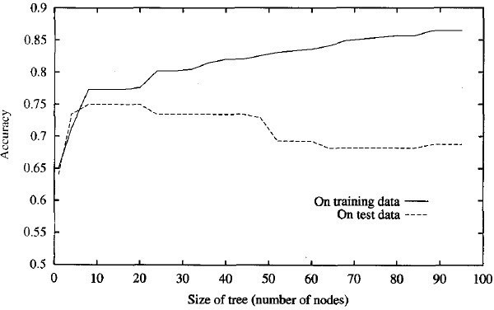
Limitations of ID3 Algorithm (Contd….)
The figure illustrates the impact of overfitting in a typical application of decision tree learning

Slide 35
Determine the Correct Final Tree Size
Regardless of whether the correct tree size is found by stopping early or by post-pruning, following criterion is to be used to determine the correct final tree size:
Training and Validation sets: Use a separate set of examples, distinct from the training examples, to evaluate the utility of post-pruning nodes from the tree.
Use all the available data for training, but apply a statistical test to estimate whether expanding (or pruning) a particular node is likely to produce an improvement beyond the training set.
Use measure of the complexity for encoding the training examples and the decision tree, halting growth of the tree when this encoding size is minimized. This approach is called the Minimum Description Length .
MDL — Minimize : size(tree) + size (misclassifications(tree))

Slide 36
Determine the Correct Final Tree Size- Training and Validation Sets
The learner may be misled by random errors and coincidental regularities within the training set, the validation set is unlikely to exhibit the same random fluctuations.
We use a validation set to prevent overfitting using following techniques:
Reduced Error Pruning
Rule Post-Pruning

Slide 37
Reduced Error Pruning
Reduced-error pruning (Quinlan 1987), consider each of the decision nodes in the tree to be candidates for pruning.
Pruning a decision node consists of removing the subtree rooted at that node, making it a leaf node, and assigning it the most common classification of the training examples affiliated with that node.
Nodes are removed only if the resulting pruned tree performs no worse than-the original over the validation set.
Reduced error pruning has the effect that any leaf node added due to coincidental regularities in the training set is likely to be pruned because these same coincidences are unlikely to occur in the validation set

Slide 38
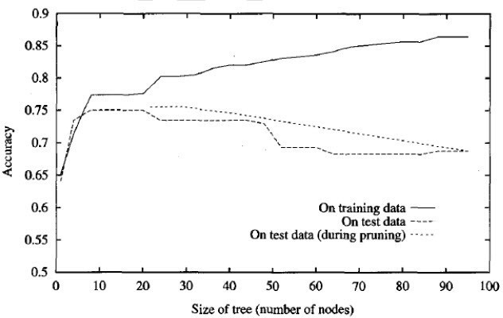
Reduced Error Pruning
The major drawback of this approach is that when data is limited, withholding part of it for the validation set reduces even further the number of examples available for training.

Slide 39
Rule-Post Pruning
Infer the decision tree from the training set, growing the tree until the training data is fit as well as possible and allowing overfitting to occur.
Convert the learned tree into an equivalent set of rules by creating one rule for each path from the root node to a leaf node.
Prune (generalize) each rule by removing any preconditions that result in improving its estimated accuracy.
Sort the pruned rules by their estimated accuracy, and consider them in this sequence when classifying subsequent instances.

Slide 40
Rule-Post Pruning (Contd….)
In rule post-pruning, one rule is generated for each leaf node in the tree.
Each attribute test along the path from the root to the leaf becomes a rule antecedent (precondition) and the classification at the leaf node becomes the rule consequent (postcondition).
For example, the leftmost path of the tree in figure (in slide 30) is translated into the rule IF (Outlook = Sunny) ^ (Humidity = High) THEN PlayTennis = No
Next, each such rule is pruned by removing any antecedent, or precondition, whose removal does not worsen its estimated accuracy.
Given the above rule, rule post-pruning would consider removing the preconditions (Outlook = Sunny) and (Humidity = High)

Slide 41
Rule-Post Pruning (Contd….)
It would select whichever of these pruning steps produced the greatest improvement in estimated rule accuracy, then consider pruning the second precondition as a further pruning step.
No pruning step is performed if it reduces the estimated rule accuracy.
Advantages of Rule-Post Pruning:
Converting to rules allows distinguishing among the different contexts in which a decision node is used.
Converting to rules removes the distinction between attribute tests that occur near the root of the tree and those that occur near the leaves.
It avoid messy bookkeeping issues such as how to reorganize the tree if the node is pruned while retaining part of the subtree below this test.
Converting to rules improves readability.
root

